Slide 1



BLDEA's V P Dr PG Halakatti College of Engineering &Technology College
Dept of CSE(AIML)
MINI PROJECT (BCS586)
Recipe Recommendation System
By,
SAMARTH MOKASHI,
SATISH SORAGANVI
Guided By,
Proff Gurudevi. Koluragi

Slide 2
CONTENTS:
1. ABSTRACT
2. PROBLEM STATEMENT
3. METHODOLOGY
4. WORKFLOW
5. SAMPLE OUTPUTS
6. CONCLUSION

Slide 3
ABSTRACT
This documentation provides a comprehensive overview of a recipe recommendation system designed to suggest recipes based on nutritional values and ingredients provided by the user.
The system leverages machine learning techniques and a web application framework to deliver personalized recipe recommendations.
Built with Flask for the backend and Bootstrap for the front-end, the system generates and displays tailored recipe recommendations, enhancing meal planning and supporting diverse dietary needs.

Slide 4
PROBLEM STATEMENT
In today's fast-paced world, people often struggle to find recipes that align with their specific dietary preferences, nutritional requirements, and available ingredients.
The main challenges include:
Dietary Preferences and Restrictions: Individuals have diverse dietary preferences and health considerations, such as low-calorie diets, low-fat meals, or specific macronutrient ratios.
Ingredient Availability: Users may have a limited set of ingredients available and need recipes that can be made using these.
Information Overload: Searching through vast databases without personalization can be time-consuming and overwhelming.
Lack of Nutritional Insights: Many recipe recommendation systems do not effectively integrate detailed nutritional data into their suggestions.

Slide 5
METHODOLOGY
The methodology for the Recipe Recommendation System involves a series of steps that integrate data processing, machine learning, and web application development. Below is a structured approach:
1. Data Collection:
Use a dataset (recipe_final (1).csv) containing recipe details, including ingredients and nutritional values.
2. Data Preprocessing:
Ingredient Processing: Convert ingredients into numerical vectors using TF-IDF vectorization. (Term Frequency-Inverse Document Frequency) .
Numerical Feature Normalization: Standardize nutritional data (calories, fat, protein, etc.) using Standard Scaler.

Slide 6
3. Model Selection:
Use K-Nearest Neighbors (KNN) algorithm to identify similar recipes based on Euclidean distance in the combined feature space.
4. Web Application:
Backend: Use Flask for handling user inputs and processing recommendations.
Frontend: Build a responsive interface using Bootstrap.
5. Display Results:
Display recommended recipes, including name, ingredients, and images on a user-friendly web interface.

Slide 7
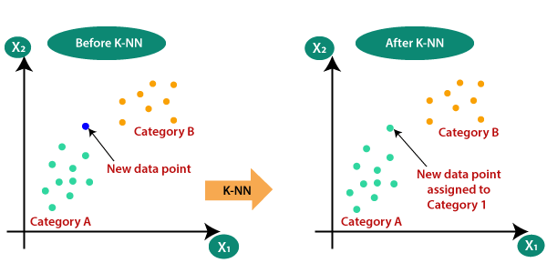
K-Nearest Neighbors (KNN):
Type: Supervised learning algorithm.
Used for: Classification and regression.
Basic Idea: To predict the class or value of a data point based on the 'k' most similar data points in the training set.
How KNN Works
Choose the number of neighbors (k):
Select the number of neighbors (k) to consider for making the prediction.
Calculate distances:
Compute the distance between the new data point and all the training data points. Common distance metrics include Euclidean, Manhattan, and Minkowski distances.
Identify the nearest neighbors:
Identify the 'k' training data points that are closest to the new data point based on the calculated distances.
Make a prediction:
Prediction
Classification
recommendation

Slide 8
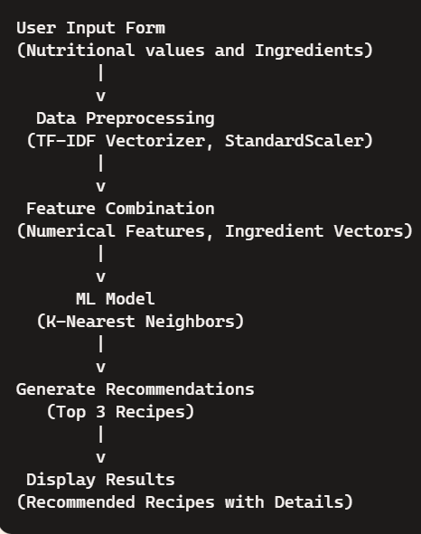
WORKFLOW

Slide 9
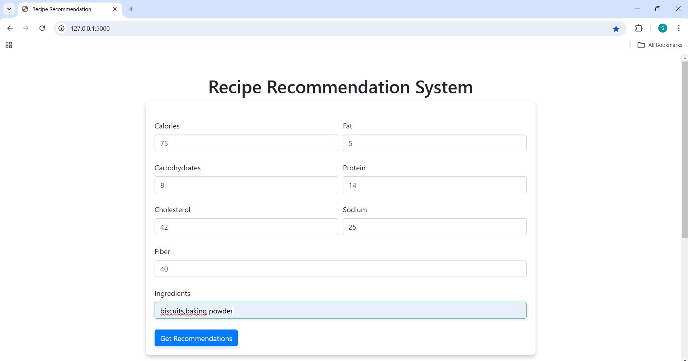
SAMPLE OUTPUTS

Slide 10
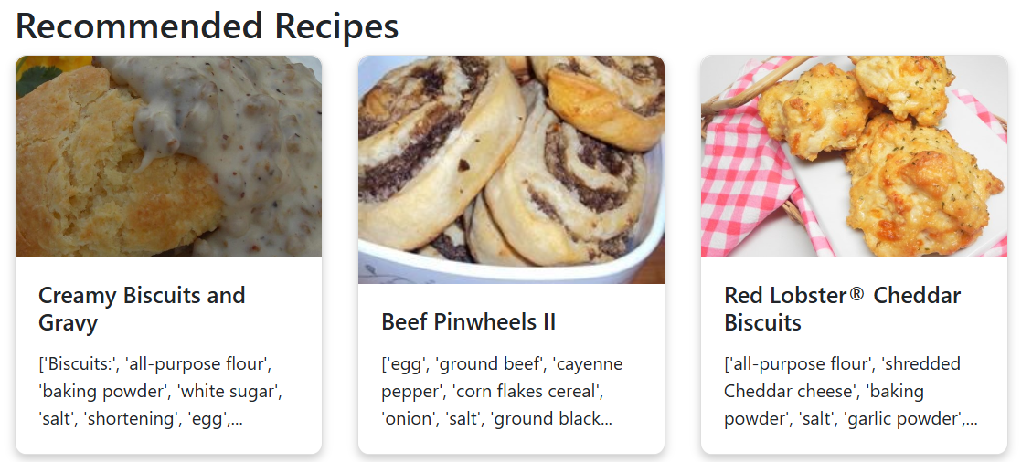

Slide 11
CONCLUSION
This recipe recommendation system integrates data processing, machine learning, and web development to provide a personalized experience for users seeking recipe recommendations.
By leveraging advanced techniques like TF-IDF vectorization and KNN, the system effectively matches user preferences with suitable recipes, enhancing the overall experience.
Dietary Customization: Extend the system to handle more complex dietary restrictions (e.g., vegan, gluten-free, diabetic-friendly) for more personalized results.

